Slide 1
Safeguards Knowledge Management Action Plan
13 November 2025

Slide 2
Presentation Overview and Objective
Office of Safeguards
Development of the Safeguards KM Action Plan
Desired outcomes and progress to date
Partnerships
Objective:
Share our experience with organizations that may be able to apply similar approaches and give feedback

Slide 3





What does the ADB Office of Safeguards Do?
Policy Compliance Oversight
Operations Support
Knowledge and Capacity
Safeguard policy
Project preparation and safeguards due diligence
Guidance, good practice notes, and tools
Safeguards business
process
Staff and client capacity building
Technical advice and
policy interpretation
Complaints management
Knowledge transfer to new staff and from those leaving
Business process management, monitoring, and reporting

Slide 4
Why Knowledge Management?
To do better safeguards and align with the ADB Knowledge Management Action Plan
Plus, creation of the Office of Safeguards (OSFG) and recruitment of many new staff created a need for:
systematic knowledge sharing, reflection, and learning processes
improved onboarding and transition support, including team building to create the new office

Slide 5
How was the KMAP Developed?
Needs Analysis
KMAP Drafted
AUG–NOV 2022
AUG 2022–DEC 2023
Survey sent to 150 people was filled in by 80 people (53%) identified these needs:
Knowledge Mapping Exercise
Improve the translation of lessons into concrete improvements
Strengthen handover/takeover processes, staff transitions, and support for new hires
Improve consistency in how documents and records are kept
Strengthen consistency and credibility of safeguards decisions in projects
Capacity building to deliver the skills, competencies, and behaviors needed for safeguards work
JAN–APR 2024
15 workshops with 28 OSFG staff
identified:
Critical knowledge
Where that knowledge resides
How knowledge flows between people
Gaps in knowledge
Notes:
Prepared based on 95 consultations with safeguards and non-safeguards staff
Published in Oct

Slide 6
Safeguards KM Vision:
“Continuously improving our practices to deliver better safeguards”

Slide 7
Learning culture
Information governance
Alignment
KMAP Desired Outcomes
Better Safeguards
Coordination
Capacity strengthening
Knowledge continuity
Notes:
Given our limited capacity, we didn’t include indicators to measure impact.

Slide 8
Learning culture
Alignment
KMAP Desired Outcomes
Better Safeguards
Coordination

Slide 9
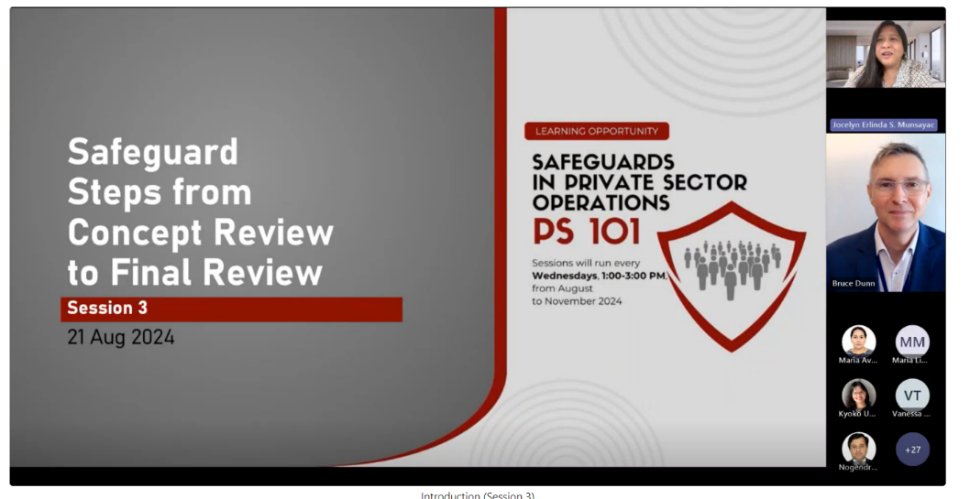
Learning Culture
OUTCOME
Progress
Learning culture established to enable continuous improvement and adaptation to change and staff up to date on good international practices
Conducted staff training courses
Facilitated external learning opportunities and sharing through presentations at international conferences.
Have documented lessons and recommendations for hydropower projects
Training program on private sector operations

Slide 10

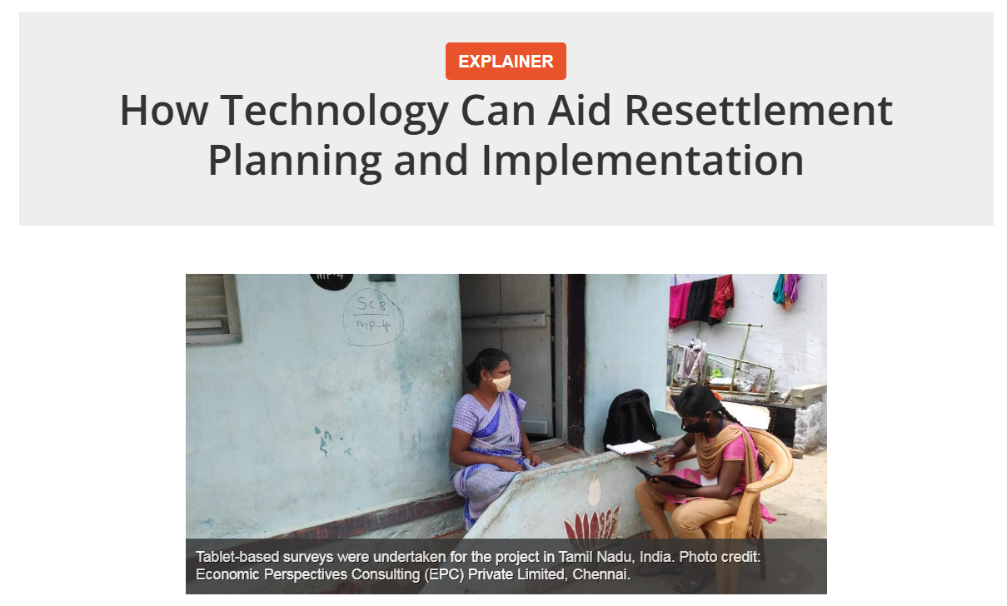
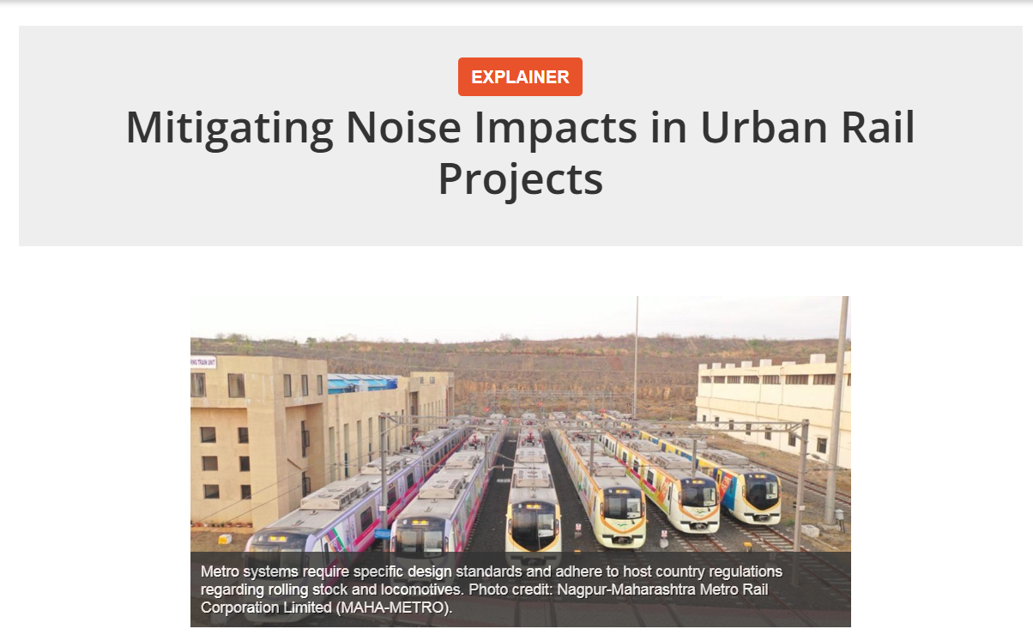
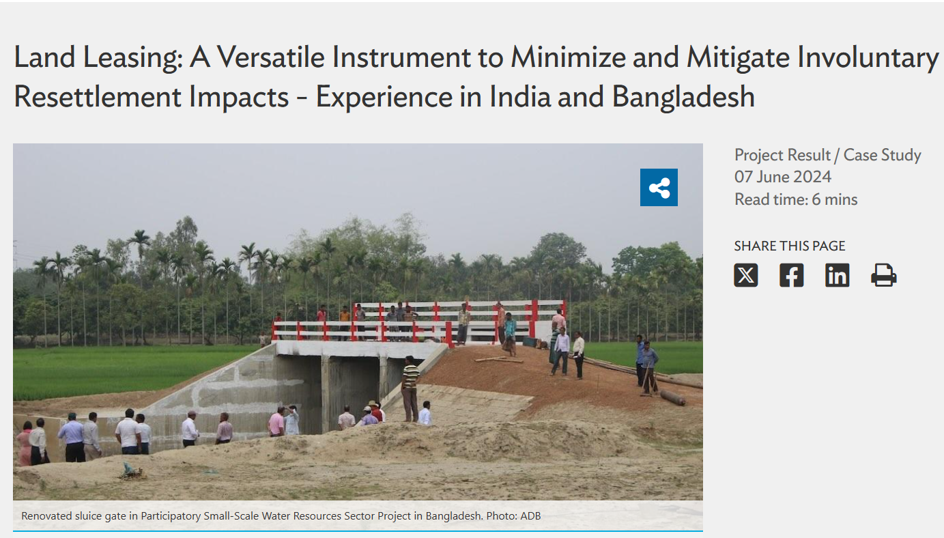
Progress
Plans
OSFG staff share experiences and lessons through hybrid learning sessions and publications
Develop a more formal annual learning agenda based on identified needs
Review KMAP implementation and explore creating indicators to measure impact

Slide 11
Information governance
Alignment
KMAP Desired Outcomes
Better Safeguards
Coordination

Slide 12
Information Governance
OUTCOME
Information governance system allows staff to find information they need, including information on past activities and decisions
Progress
Plans
Safeguards community site contains a wealth of information that is easy to navigate, new information is highlighted in the OSFG hubsite and OSFG Weekly email
Safeguards Agent utilizes AI trained on 35,000 safeguard documents
Developing a digital tools work plan
SharePoint folder structure and protocols developed
Drafted guidelines and procedures for developing OSFG knowledge products and services
Established a KM Working Group but it is underutilized
Published three issues of the OSFG newsletter.
Transition to new SharePoint platform
Do user testing on the new platform and implement improvements
Complete and share KM guidance
Implement digital tools work plan
Utilize the KM Working Group to guide and expand OSFG’s KM work

Slide 13
Alignment
KMAP Desired Outcomes
Better Safeguards
Coordination
Knowledge continuity

Slide 14
Knowledge Continuity
OUTCOME
Progress
Plans
Knowledge continuity ensures that new staff are brought up to speed effectively, and that we reduce the risk of knowledge loss when key people leave.
Developed an OSFG onboarding program that includes written guidance, a meet and greet with the head of OSFG and presentation on OSFG
All new staff attend safeguard training, includes sharing from experienced staff
Mapped dependency on critical knowledge and expertise, identified risks and gaps.
Continue to interview staff before they leave ADB for them to share lessons learned and guidance.

Slide 15
Alignment
KMAP Desired Outcomes
Better Safeguards
Coordination
Capacity strengthening

Slide 16
Capacity Strengthening
OUTCOME
Progress
Capacity development needs in OSFG are regularly tracked, and training and knowledge sharing events are geared towards meeting current gaps and emerging needs
Mapped competencies and skills against key safeguard activities, and identified gaps and needs
Communications and outreach program: developed the hubsite, community site, OSFG Weekly and OSFG newsletter.
New policy rollout – implementing a change management program for ADB staff and clients

Slide 17
Rollout of the Environmental and Social Framework
Change management
      campaign on the value of safeguards: identified motivations and negative attitudes, created two videos, conducting meetings will all operations teams
      campaign on new policy: focus on face-to-face communications using ADKAR methodology (awareness, desire, knowledge, ability, reinforcement)
In-person training for staff and DMCs
Thematic training and clinics
eLearn courses

Slide 18



Partnerships
      Multilateral Financing Institutions Working Group on Environmental and Social Standards: chair group that shares training materials and knowledge products (includes AfDB)
      Environmental and Social Safeguards Community of Practice to conduct joint training sessions (with other MFIs and related organizations)
      ADB chairs the KM community of practice for IFIs (includes AfDB)
      Consultations and discussions with civil society organizations
Notes:
We chair the WG on capacity building – includes AfDB

Slide 19
Partnerships
Association of Labor Unions
MOU with Building and Wood Workers’ International – joint training and project visits
International Valuation Standards Council
ADB is a member – joint training
International Labour Organization (ILO)
Joint training and assessment in Pakistan
Notes:
We chair the WG on capacity building – includes AfDB

