Slide 1
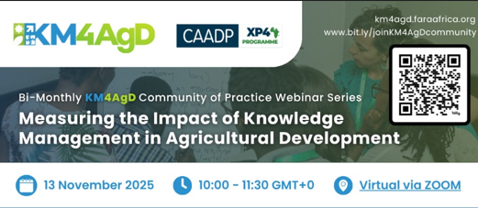
Measuring the Impact of KM in Ag Development – Personal insights from the perspective of an international research organization
Simoen Staiger
13 November 2025
Notes:
This is my personnel perception, not an institutional view. Focus on how KM evolved and when we really started to focus on impact

Slide 2
Trends, priorities and KM practice over 25 years
Vision of
success
Competitive advantage
Expertise
Behavior change
Partnerships
Adaptive management
Quality research & fund raising
Forge collaboration of teams
2001
2005
2010
2015
2020
2025
KM strategy, program, team
Experimentation & engagement
Institutionalization
Improvement of collab. research
Learning
Objective
There is a world outside our institutional boundaries!
Let’s experiment with tools and methods!
We need policies (open access)!
We can apply KM in collaborative research!
We have to apply MELIA in KM!
Let’s focus on knowledge sharing again!
Focus of
KM folks
Timeline
Vision
Discovery
Information mgt
Big data
AI
Notes:
2001: World Bank, discovery of knowledge as an asset, decision to invest, a vision
2005: Starting to implement the vision. Seed money from Canada to get some people trained, try out KS methods and tools, ICT-KM Program with larger scope across data-info-knowledge spectrum, KM4Dev engagement, knowledge fairs, communities of practice
2010: Change in course, CG prioritizes open access, Triple A, focus on data and information
2015: Focus on services to researchers data systems, big data
2020: Technology integration on the one hand, MELIA – driven KM on the other hand

Slide 3
Critical reflections on current MELIA trends
Theories of change are becoming an instrument for planning and budget allocation
We experience and increased focus on impact which is beyond our sphere of control
The priority focus on outcomes requires investment in qualitative evaluations which is lacking
We do not invest in MELIA of partnerships
The decolonization debate related to KM and MELIA had emerged but almost disappeared (in our organization)

Slide 4
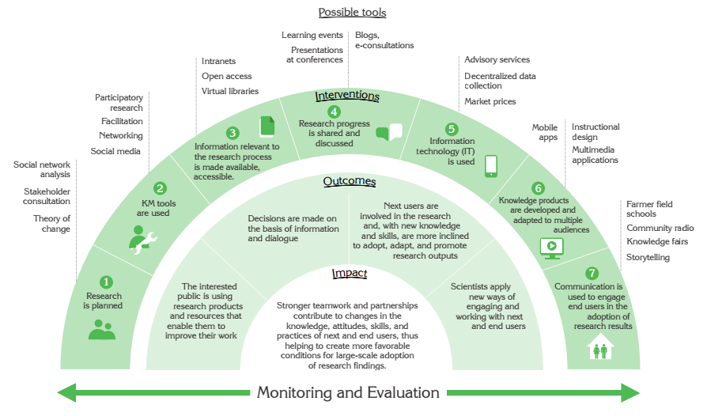

Slide 5
Thanks!
Simone Staiger-Rivas s.staiger@cgiar.org
alliancebioversityciat.org

