Slide 1







A SCALING OUT FRAMEWORK FOR AGRICULTURAL RESEARCH and INNOVATIONS
Silim M Nahdy (PhD)
AFAAS-Executive Director

Slide 2
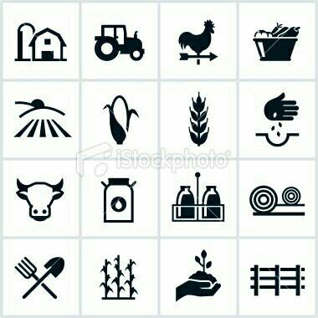
Defination.
Scaling = sustained process to increase the use of innovations to address needs over time and across geographies
IIRR (2000): “Scaling up brings more quality benefits to more people over a wider geographical area, more quickly, more equitably, and more lastingly
Fig 2. Adoption and abandonment of structural SWC technologies in La Paz, Honduras. Project duration 1980-1991. Direct incentives provided 1984-1991. Number of farms -147.
Infiltration ditches

Slide 3
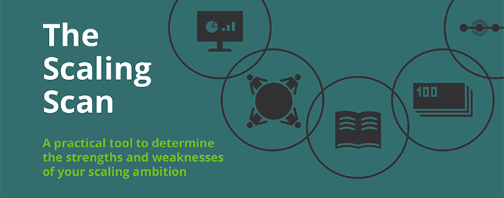


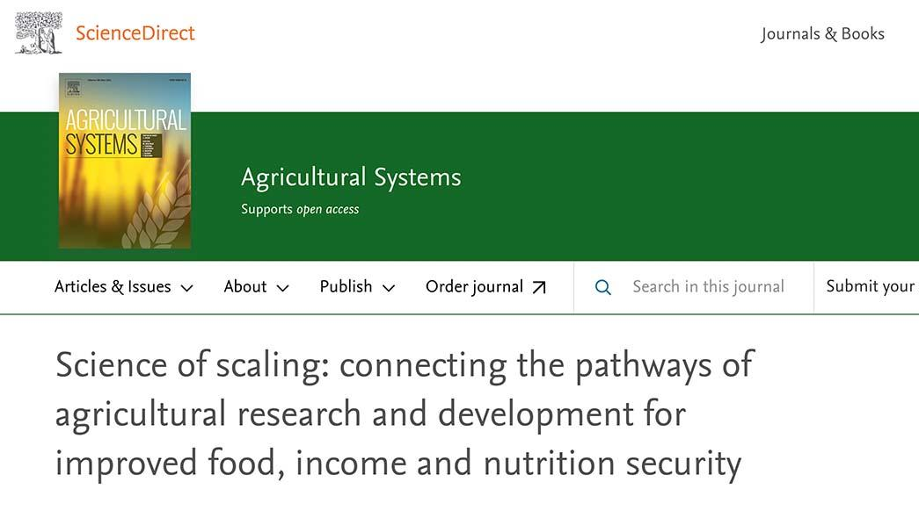
No quick fix for scaling
Scaling takes decades, not years
Successful pilots are no guarantee for success at scale
Scaling depends on long term investment, willingness and ability of local actors to sustain and grow to scale
Scaling can have unintended adverse effect
Lots of confusion on the what and how of scaling
………..….
Notes:
Successful pilots, or projects, are no guarantee for success at scale and in the long term

Slide 4

Change the way we think about and do scaling
Islands of initatives does not constitute Scaling. Islands have led largely to pockets of very local short-lived success that do not lead to lasting change
  Resource waste,
Notes:
Successful pilots, or projects, are no guarantee for success at scale and in the long term

Slide 5
UNDERSTANDING SCALING
01
01
HIERARCHICAL
Scaling through top-down, planned programmes that are often driven by strong central leadership.
HIERARCHICAL
RELATIONAL
Scaling through networks, social links and informal groupings that aim to promote the accumulation of social capital through decentralization, participatory methods, and empowerment techniques
DIFFUSION
02
03
DIFFUSION
Scaling motivated by individual interest leading to individuals’ actions, “mediated in a marketplace for goods, services, and ideas” ( ----> resulting in diffusion of technologies to others)
02
03
02
RELATIONAL

Slide 6
Framework for Scaling
Key elements of scaling:
  Sustained intervention and learning over time
  Appropriate Policies and Institutional support
  Knowledge of available Technologies and Innovation,
  Human capital development,
  Range and Capacity of Scaling Pathways
  Continuous generation, dissemination and access of appropriate Knowledge and Information and R & I
  M&E

Slide 7

ROLE OF AEAS IN SCALING

Slide 8
Services Required at Farm Level.
Production
Organization.
Brokering.
Advocacy.
Networking:
etc……………
Post-production.
Business planning & marketing.
Some Areas of
Services

Slide 9
AEAS DELIVERY –Some Broad Categories
Publicly delivered model
Public-Private Partnership (PPP) -
Pluralistic Extension Model
Some Pluralistic non –public categories
Farmer/Cooperative,
NGOs
Social Enterprise: provision of services while generating revenue through sales of products or services
Market-Based: market based delivered eg input suppliers & companies providing technical assistance
Knowledge Brokerage: agents act as intermediaries, connecting farmers with knowledge, resources, and markets
Private Sector – Fee-for-Service
Digitalized Extension –e-extension

Slide 10
AGRICULTURAL ADVISORY - AND EXTENSION – Some nomenclature
FFS -Farmer Field Schools – mixed (public, NGOs)
VEC: The Value-Chain Extension
IP -Innovation Platforms - Mixed
BDS: Business development services -Private
TM -Twigire Muhinzi Extension -Mixed
ESP: Embedded Service Provider
ABDS - Agricultural business development services -Private .
AEAS Nomenclature
VBA: The Village based Development Advisor -Private
RBDS: Rural business development services -Private
VAM: Village Agent Model -Private

Slide 11
To Note
No “best fit practice or a magic model” for all situations and countries. Best models need to be flexible, participatory, and sustainable (“smart”) to meet conditions of different countries and farming systems.
Some examples;
The use of ICTs is essential for enhancing the effectiveness of AEAS, regardless of the specific extension method being used. Some AEAS methods are championed by architectures hence, these need to be objectively studied to contextualize
NOTE:.

Slide 12

DIGITALISATION OF AEAS

Slide 13
High potential for scaling - improve productivity, efficiency and sustainability Specifically:
Improved accessibility -Increased reach
Enhanced knowledge sharing
Cost-effectiveness
Data-driven decision-making
Personalized advice and support
Real-time updates
Empowerment of women and youth
Ease of scalability
Integration with other services
Why Digitalize

Slide 14
Digital Advisory Services:
E-Extension Platforms
Mobile Apps:
Crowd funding platform
Online Training and Capacity Building:
Digital Marketplaces: - Connecting demand and supply
Social Media and Online Communities: -
Data Analytics and Precision Agriculture
Digital Farmer Profiling:
Online Monitoring and Evaluation
……………………
Examples of Digital AEAS

Slide 15
Mobile devices and apps
Web platforms and portals and Social media platforms
Mobile apps (farm management, advisory, market prices)
E-learning platforms, Digital content creation, Digital extension material development
Data analytics and visualization tools, Satellite imaging and remote sensing techs
Drone technology
Artificial intelligence and machine learning algorithms
Online survey and feedback tools
Digital payment systems
Geographic Information Systems (GIS)
Online marketplaces and e-commerce platforms
Podcasting and video conferencing tools
Online community and forum software
Monitoring and evaluation software
Etc ……..
Some Tools used

Slide 16


Some Digital Tools used
Mobile devices and apps
Web platforms and portals and Social media platforms
Mobile apps (farm management, advisory, market prices)
E-learning platforms, Digital content creation, Digital extension material development
Data analytics and visualization tools, Satellite imaging and remote sensing techs
Drone technology
Artificial intelligence and machine learning algorithms
Online survey and feedback tools
Digital payment systems
Geographic Information Systems (GIS)
Online marketplaces and e-commerce platforms
Podcasting and video conferencing tools
Online community and forum software
Monitoring and evaluation software
Etc ……..

Slide 17
AI & ML Digital Technology
AI and ML makes digitalized AEAS precise, efficient, and effective, leading to improved agricultural productivity and sustainability. Some key roles of AI and ML include:
Predictive analytics: AI algorithms analyze data to predict weather patterns, soil moisture and crop yields, enabling farmers make informed decisions.
Personalized recommendations
Automated decision support systems
Crop disease detection
Farm robotics and automation
Natural Language Processing (NLP): personalized support and answers
Data analysis and visualization: help agents and farmers make sense of large datasets,
Farm management software
Weather forecasting
Supply chain optimization: optimize logistics, connecting with markets etc
Why AI & ML

Slide 18
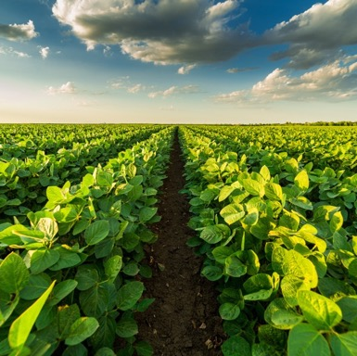
Framework: Some initial Focus areas
Strengthen Policy and Institutions
Strengthen and stimulate Demand side
Develop physical and virtual platforms (marketplace) where supply meets demand (Fig 1)
Strengthen Supply side of technologies, innovations – capacities, skills , knowledge

Slide 19
Fig1. PLATFORM/MARKETPLACE FOR INNOVATION
DEMAND & NEEDS
Sustainably increase production, productivity and profitability;
Data & information,
services (capacity building, agri-businesses development, institutional & organizational development,
partnership
opportunities,
Funding…….
VIRTUAL & PHYSICAL MARKETPLACES
Networking,
Brokerage
Standards & regulations,
incentives,
Market-making
Different Funding streams
Subsidies, ………
SUPPLY
Technologies,
methods for innovation,
information, training courses,
Funds, investment
opportunities,
partners, …..

Slide 20


