Slide 1
Bridging KM, research and policy for food system transformation
Michael Victor
Head, Communications, advocacy and knowledge management
KMAg4Dev webinar series

Slide 2
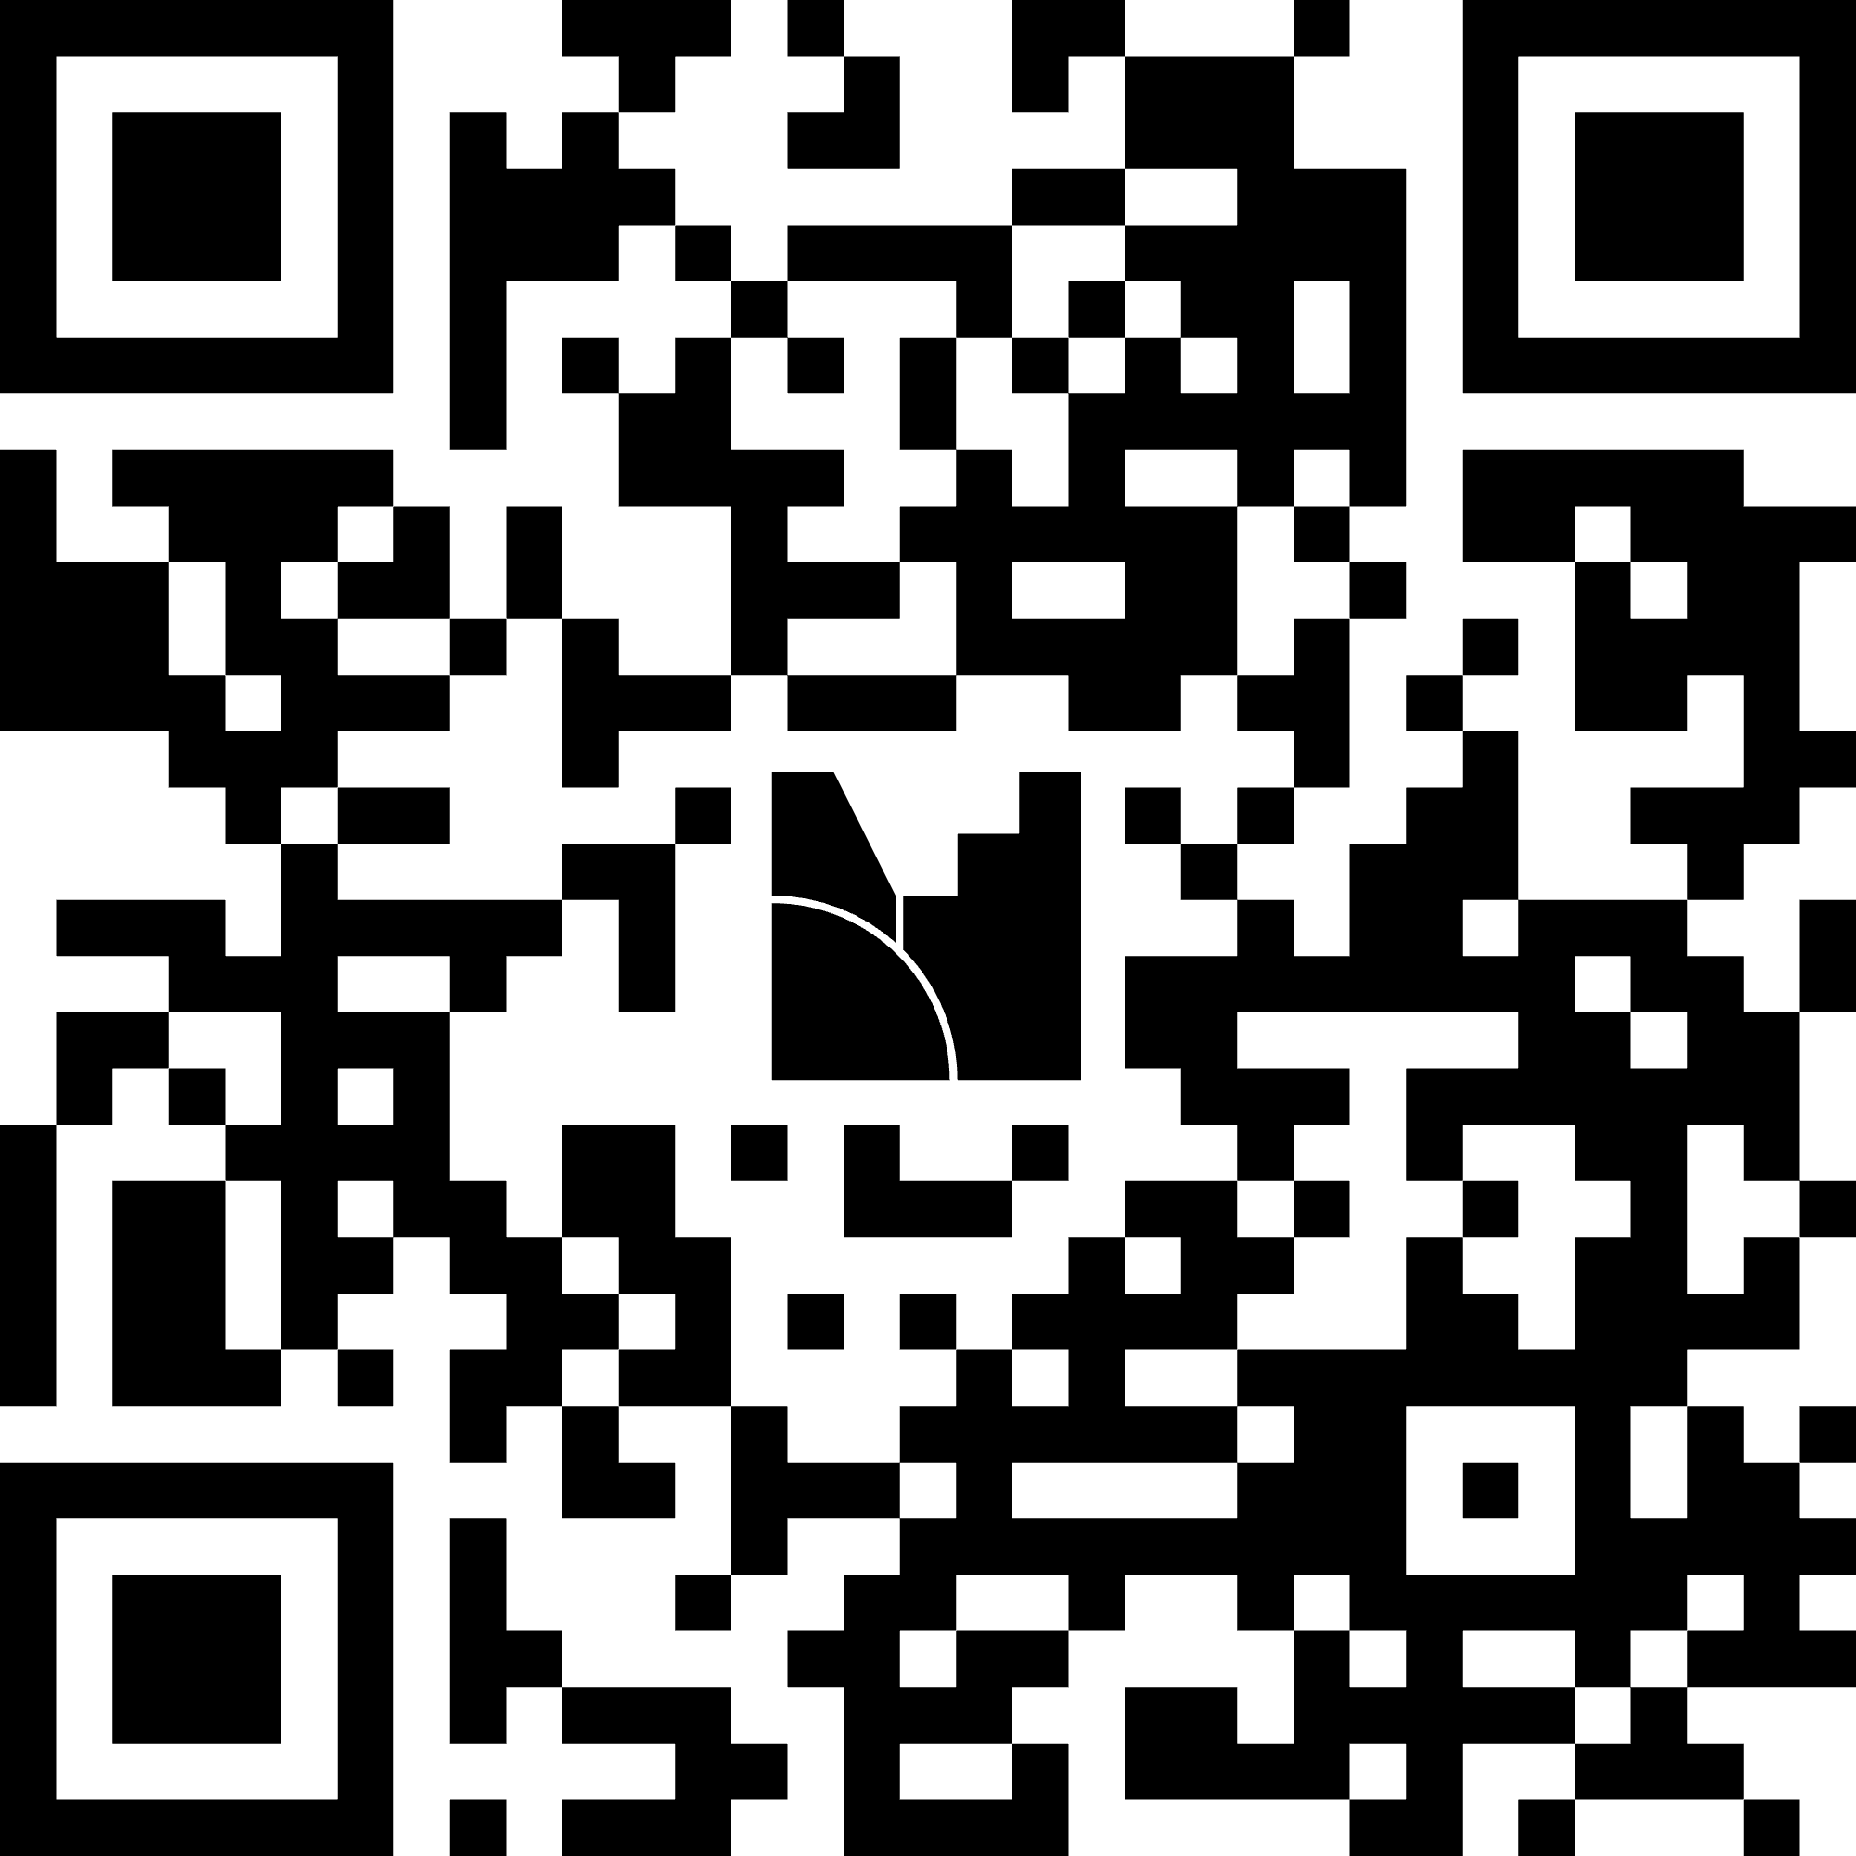
Menti
www.menti.com
Code: 4332 6947

Slide 3
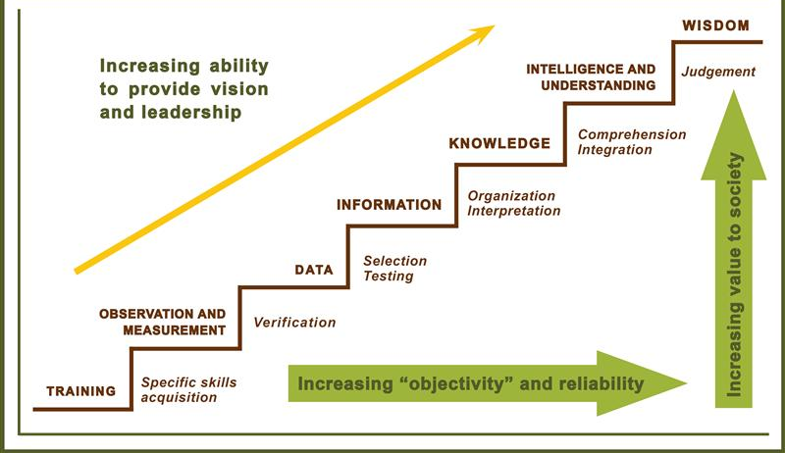
Knowledge into Use for policy decision making – theory
Structured processes to effectively generate, share, and apply research and evidence for informed decision-making and effective policymaking.
KM systems create pathways for translating research into actionable knowledge, linking researchers with policymakers and other actors to foster innovation and address complex challenges

Slide 4
Reality: Messy process

Slide 5
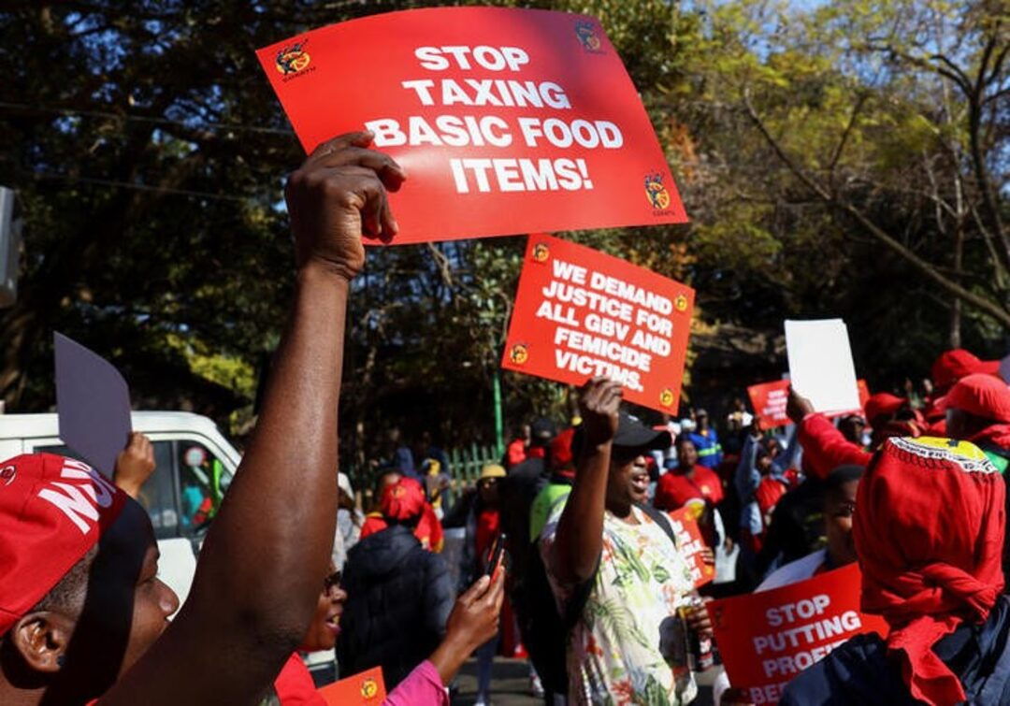
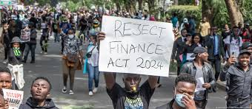
How is policy made?
Political agenda
Dominated by crisis or concerns
  Reactive decision-making (no proactive)
Based on interpretations and understanding, rather than evidence
Influenced by personal interactions
External agenda (donor, private sector, etc.)

Slide 6
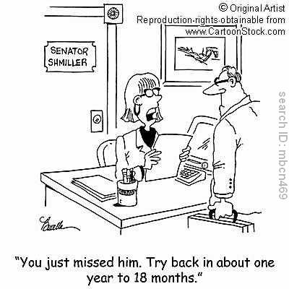
Challenges in reaching decision‑makers
Timing & policy windows rarely align with research cycles
Access: decision‑makers report difficulty finding relevant, high‑quality, contextualized evidence
Relationships: weak researcher–policy networks; low trust limits uptake
Format: evidence is long, technical, and not actionable Context & politics shape what counts as ‘evidence’
Notes:
Synthesize recurring barriers across systematic reviews; emphasize timeliness, relationships, and format.

Slide 7
How do policy makers make decisions? What persuades?
Blended inputs: research evidence + stakeholder interests + feasibility + politics
Relational factors: trusted intermediaries strongly influence uptake
Usable science: concise, timely syntheses (e.g., policy briefs, evidence summaries) outperform long reports
Deliberative dialogues help integrate values, local data and research
Local/sector‑specific evidence increases credibility in LMICs
Notes:
Underline that stories + data + trusted messengers work together; tailor to agriculture context with local examples.

Slide 8
Role of Knowledge Management in Research → Policy Processes
Horizon scanning & agenda‑setting: map policy windows and actors; align research questions/products to needs
Understanding demand: understanding decision-makers needs
Evidence synthesis & quality assurance: curate rapid/systematic reviews and local data; steward repositories/metadata/ concise policy briefs with options/implications; 1‑slide ‘ask’; dashboards
Knowledge brokering & relationships: facilitate linkage/exchange and deliberative dialogues; embed liaisons in ministries; build communities of practice
Capacity & systems: Open access, M&E learning; connect lab/field insights to policy
Tracking influence: monitor requests, citations, and adoption in guidelines/budgets; iterate products via user feedback

Slide 9
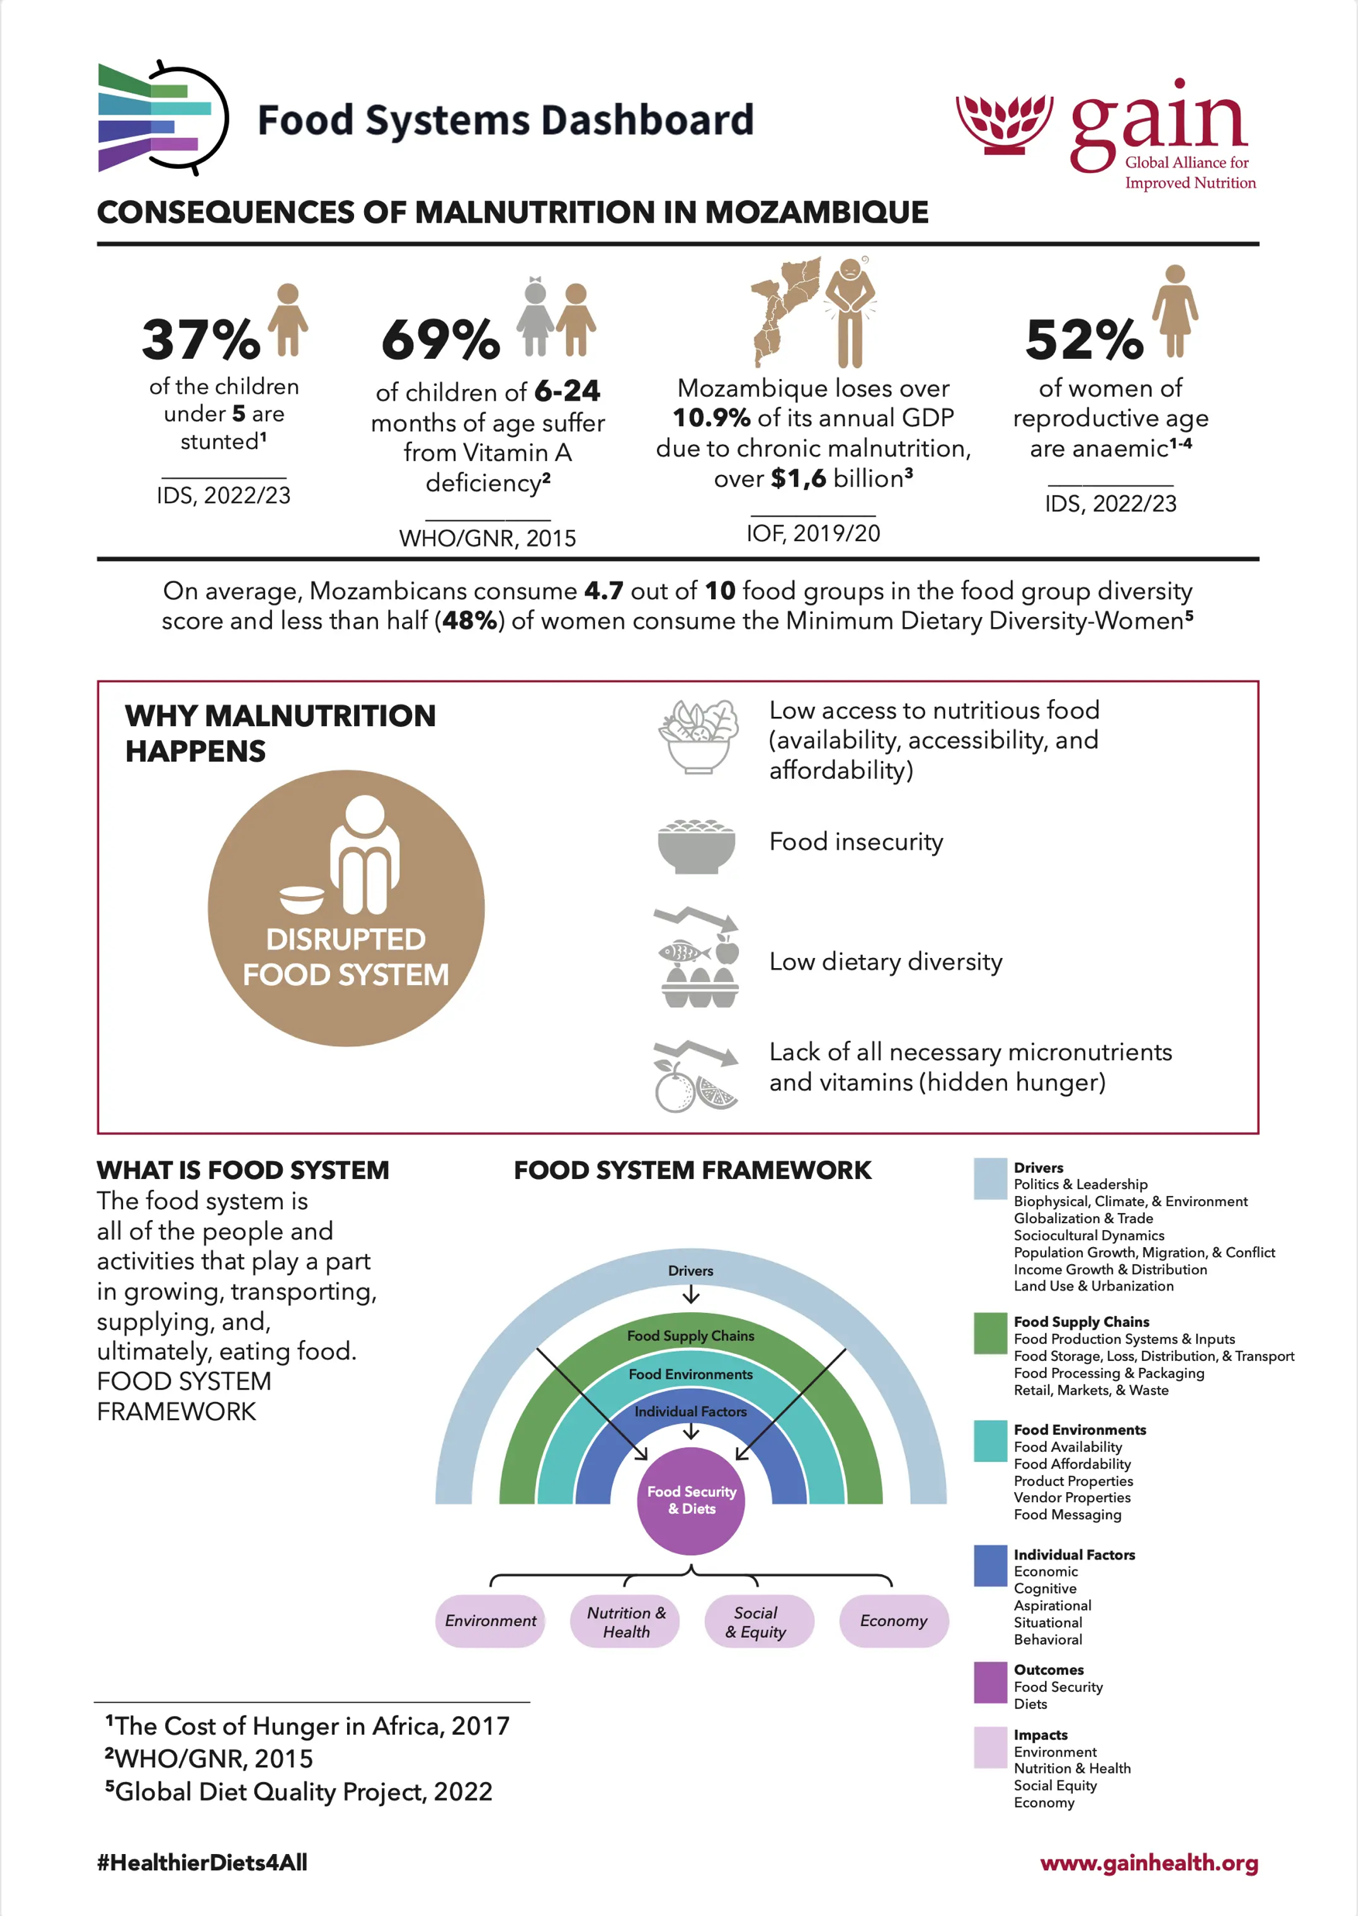
Best practices for KM practitioners in policy processes
Rapid evidence products synced to policy calendars; ‘fast‑response’ syntheses
Translation & packaging: concise policy briefs with options/implications; 1‑slide ‘ask’; dashboards linked to syntheses
Evidence dialogues & roundtables blending research + practice knowledge
Dashboards that track key indicators and link to underlying syntheses
Brokered relationships: embed KM staff as liaisons in ministries/commissions
Notes:
Show examples from agriculture or One Health where possible; stress alignment to decision cycles.

Slide 10
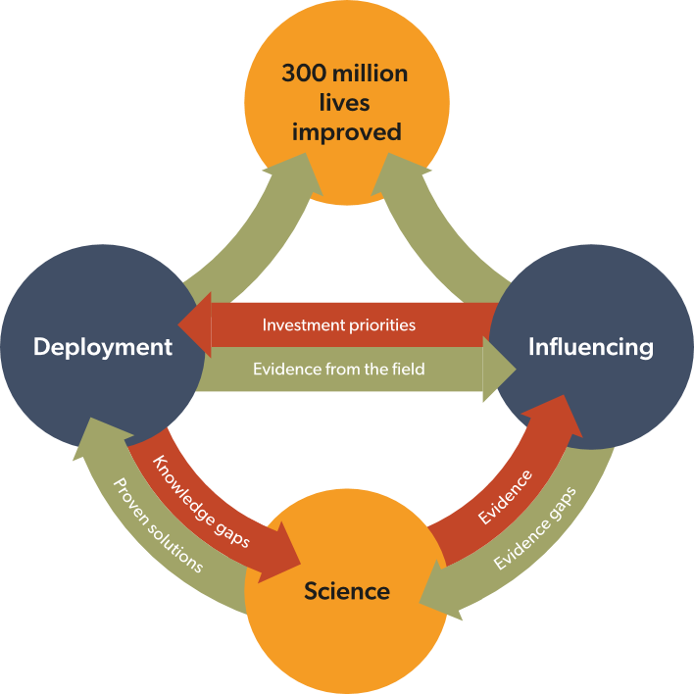
Strategic Mission and objectives
Better lives through livestock
ILRI’s mission is that:
300 million peoples’ lives in low- and middle-income countries are improved through livestock science that contributes to equitable and resilient livestock systems in order to deliver food systems transformation with climate and environmental benefits.
Objective 1
Objective 2
Strategic objective 1:
Co-design and deployment of sustainable science-based livestock solutions
Strategic objective 2: Leveraging science for policy and investment decisions

Slide 11
Types of ‘policy engagement’ as a continuum of activities, approaches in ILRI
Policy research (impact assessment, Market systems, LMPs, policy studies, etc)
Knowledge brokering (work with AGNES, etc)
Actively engaging to unblock specific social, institutional barriers
Coalition building /thought leadership
Advocating evidence based messages and points of view
Synthesis, sense making (global reviews, synthesis, message development)
Monitoring, evaluation and learning to track progress
Research
Advocacy

Slide 12
Examples

Slide 13
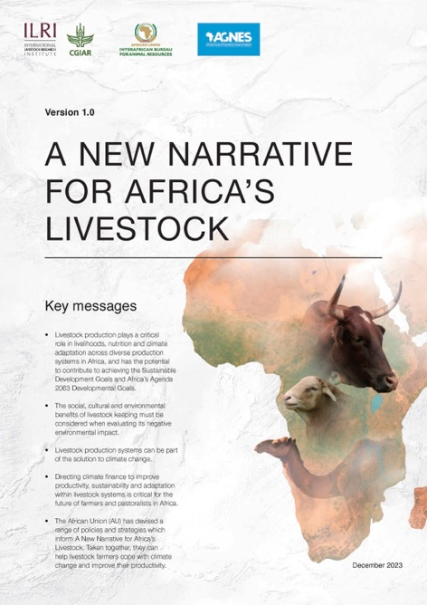
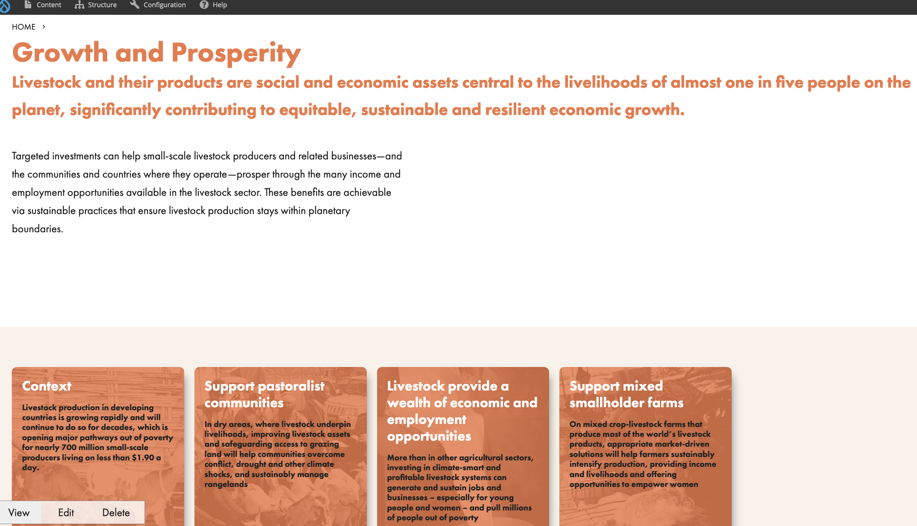
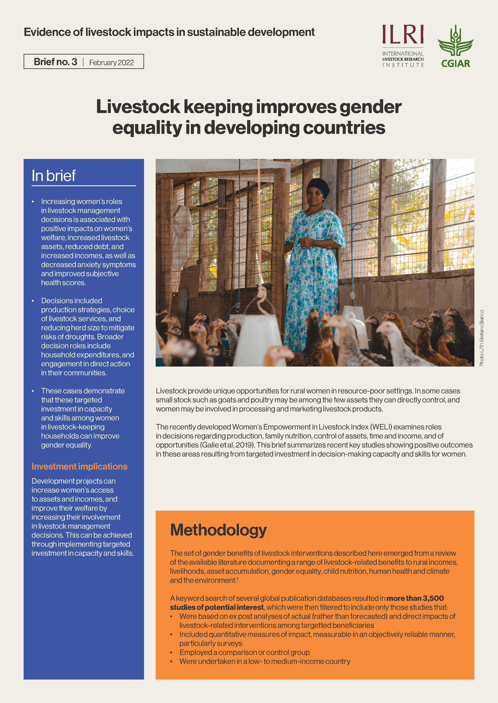

Evidence gathering
Commisioned reports
Messaging
Impact assessment synthesis

Slide 14
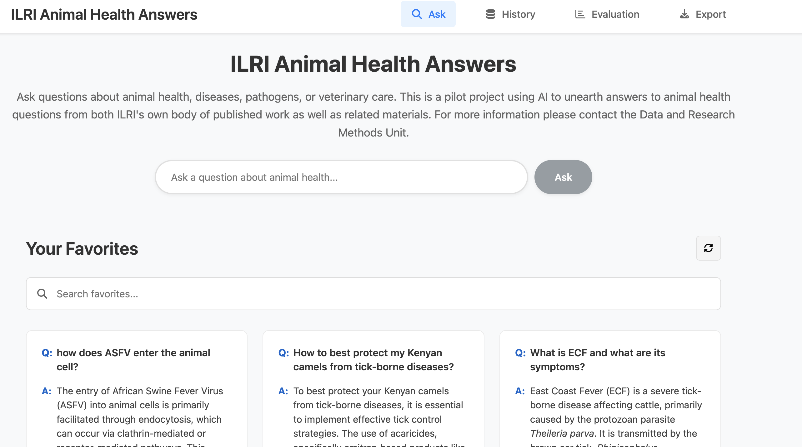
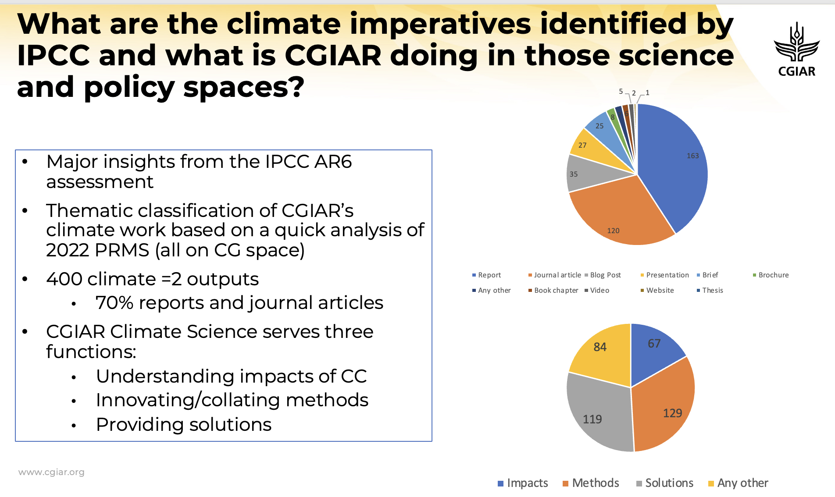
CG-Space into use
CGSpace multi-institional repository of CGIAR ouputs 170,000 entries | 126,000 open access | 46,000 journal articles
Making increasingly able to do complex synthesis of CGIAR work as well as create chat bots for quick synthesis

Slide 15
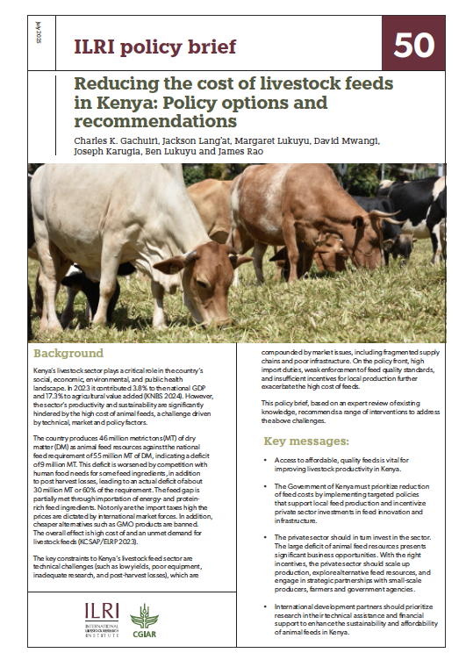
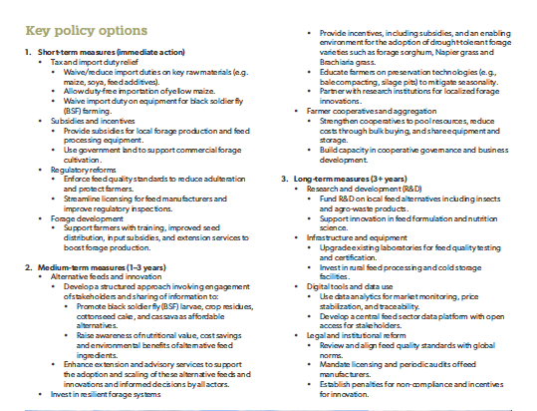
Policy briefs with clear recommendations

Slide 16
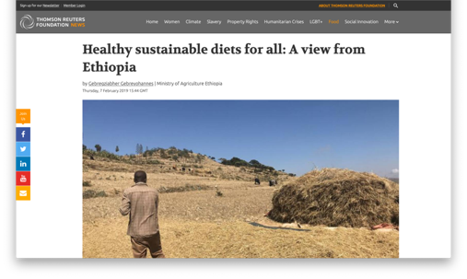
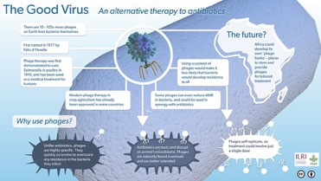
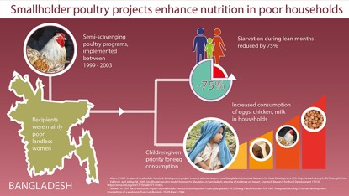
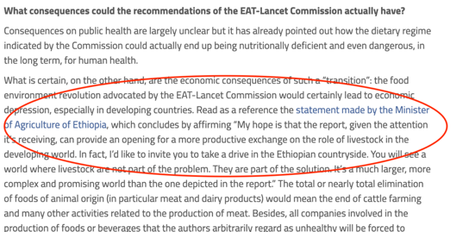
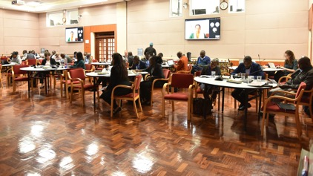
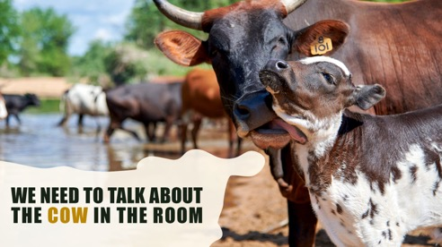
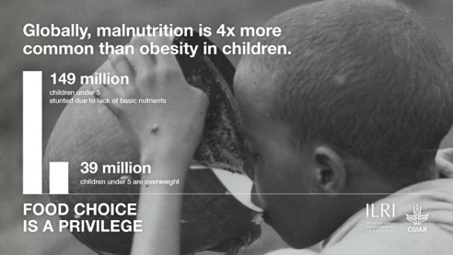
Strategic communcations
Oped-Media
Infographics
Campaigns

Slide 17
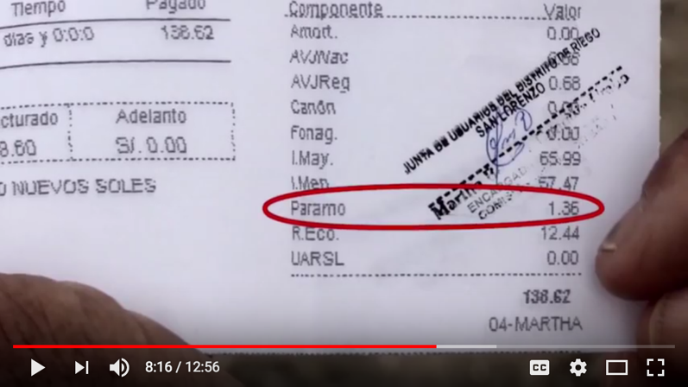
Multi-targeted strategies: Influencing Peruvian PES law
Use of film to demonstrate to Congress what a PES is
WLE supported CIAT and local researchers on long-term initiative to improve benefit sharing of water between upstream and downstream users
Getting Peruvian congress to pass law on BSM took more than 4 years -passed in 2017
Used a combination of approaches
Committed long-term researchers
Champions in the ministry
Coalition with NGOs and private sector
Film used to show clearly what PES is all about
Policy briefs and strategic presentations based on science
”Many of the congress did not understand the presentations by scientists but when they saw highlighted tax for the “paramo” the penny dropped”
-- Roger Loyala - Director, Ministry of Environment

Slide 18
5 roles that knowledge managers can play to drive policy adoption of research
Ensure repositories are open access and can be used to synthesize information
Develop innovative ways to communicate and package for speed and local relevance
Convene dialogues and support engagement – process facilitation
Support process documentation, measure uptake
Map demand and stakeholders

Slide 19

THANK YOU

